Slide 1
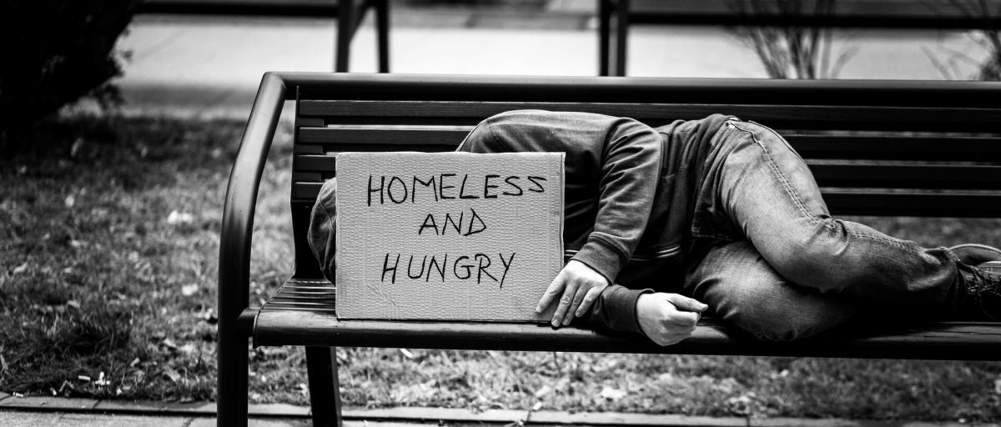
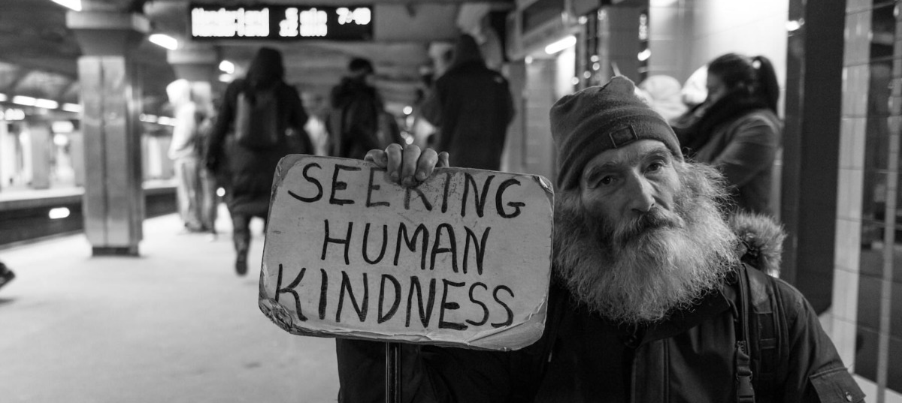
The Faces of Poverty
A presentation by: Megan Kelly, DNP, APRN, PMHNP-BC
Donnelly College
Faculty Workshop 2024

Slide 2
Presentation Objectives
Complete a poverty simulation
Understand the impact poverty has on social determinants of health
Identify specific local resources available for students to utilize
Challenge any preconceived notions about low-income families

Slide 3
Social Determinants of Health (SDOH)
Economic Stability
Education Access/Quality
Healthcare Access/Quality
Neighborhood & Environment
Social & Community Context

Slide 4
SDOH

Slide 5
National Poverty Statistics
From 2022: The official poverty rate was 11.5%, or 37.9 million individuals.
Poverty is not distributed equally by region.
Hispanics (19.3%) and African Americans (17.2%) have higher poverty rates than White and Asian groups.

Slide 6
2023 National Poverty Guidelines
Persons in family/household | Poverty guideline
1 | $14,580
2 | $19,720
3 | $24,860
4 | $30,000
5 | $35,140
6 | $40,280
7 | $45,420
8 | $50,560

Slide 7
Wyandotte county population by race
Total WYCO Population: 169,245
Race | Total Number in WYCO
American Indian/Alaskan Native | 1,917
Asian | 7,705
Black/African American | 34,589
Hispanic or Latino | 55,814
Native Hawaiian or Pacific Islander | 387
White/Caucasian | 63,079
*Data collected from the United States Census Bureau

Slide 8
Wyandotte County Statistics VS. Kansas Statistics
Wyandotte County
State of Kansas
Persons without Health Insurance | 15.4% | Persons without Health Insurance | 8.6%
Persons in Poverty | 14.7% | Persons in Poverty | 12.0%
Language other than English Spoken at Home | 30.4% | Language other than English Spoken at Home | 11.7%
Median Household Income | $59,362 | Median Household Income | $68,925
*Data collected from the United States Census Bureau

Slide 9
Poverty Simulation
https://playspent.org
Each person will login on phone or computer and complete the simulation. The table will then come together To discuss the outcomes of the exercise.

Slide 10
Reflection Questions
Pay the rent or mortgage?
Keep the utilities on?
Buy the required food each week?
Make loan payments?
Get evicted?
Take care of your children?
During the simulation, did you ever consider that you would cheat, steal money, or do something illegal?
Improve your situation throughout the month?
Look for a job?
Help others out?
Throughout the month, were you able to:

Slide 11
Why Should We Care?
to provide education and community services with personal concern for the needs and abilities of each student, especially those who might not otherwise be served.
It’s Our Mission and Duty to Do So:

Slide 12
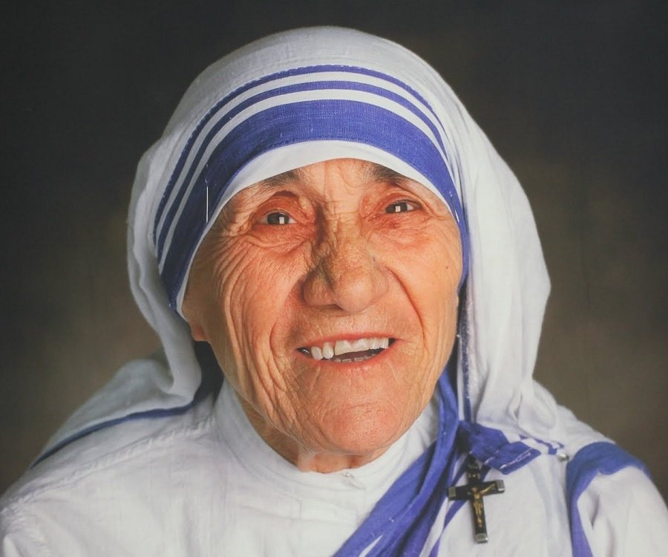
So Let’s Get Started….
Recognize issues.
Voice concerns.
Get Involved. Be the Change.
Build a sense of community.
Develop strong interpersonal relationships.
Know Resources to Help.
“Small things done with great love will change the world.” –Saint Teresa of Calcutta

Slide 13
Tackling the Problem of Poverty
Food Hardship
Housing Insecurities
Catholic Charities of Northeast Kansas
Campus Cupboard
Cross-Lines Community Outreach
Food Pantry St. Paul’s Episcopal Church
Kansas Food Assistance Program (SNAP)
Swope Health—Women, Infants, and Children (WIC)
Catholic Charities of Northeast Kansas
Housing Stability Program at Cross-Lines Community Outreach
Kansas & Western Missouri Salvation Army
Residential Maternity Shelter—Nativity House
Emergency Shelter—Friends of Yates
City Union Mission

Slide 14
Tackling the Problem of Poverty
Medical Care
Transportation
Vibrant Health
Mercy and Truth Medical Missions
Sharon Lee Family Health Care
Samuel Rodgers Health Center
United Government Public Health Center
Jaydoc Free Clinic at KU Med
Kansas City Regional Transit
Earn a Bike by Revolve KC
Medical Transportation by Swope Health
PACE By Midland Care

Slide 15
Tackling the Problem of Poverty
Job Placement
Mental Health Treatment
Goodwill
On Demand Employment Services
Kansas Dept. for Children & Families
The Village Initiative
Metro Lutheran Ministry
Bishop Sullivan Center
Catholic Charities
Mattie Rhodes Center
Compassionate Ear Warmline
The Family Conservancy
KVC Hospitals—Children’s
Wyandotte Center
Rainbow Services Inc. (RSI)
Crisis Text Line

Slide 16
References
(2011). findhelp. https://findhelp.org
(n.d.). Saint Mother Teresa of Calcutta [Review of Saint Mother Teresa of Calcutta]. Retrieved January 2, 2024, from https://www.thebestcatholic.com/2016/09/05/saint-teresa-calcutta/
“7 Key Trends in Poverty in the United States.” Www.pgpf.org, Peter G. Peterson Foundation, 25 Sept. 2023, www.pgpf.org/blog/2023/09/7-key-trends-in-poverty-in-the-united-states. Accessed 28 Dec. 2023.
Healthy People 2030, U.S. Department of Health and Human Services, Office of Disease Prevention and Health Promotion. Retrieved [4 January 2024], from https://health.gov/healthypeople/objectives-and-data/social-determinants-health
Prevention of Social Determinants of Health. Updated March 29, 2022. Accessed July 8, 2022. https://www.cdc.gov/chronicdisease/programs-impact/sdoh.htm
Social Needs and Social Determinants: The Role of the Centers for Disease Control and Prevention and Public Health. Updated September 9, 2022. Accessed 26 Dec. 2023.
Retrieved January 4, 2024, from https://findhelp.org
U.S. Census Bureau. (n.d.). Wyandotte County, KS. Explore Census Data. https://data.census.gov/profile/Wyandotte_County,_Kansas?g=050XX00US20209

