Slide 1
Fall Community Workshop
Donnelly College
August 15, 2023
Lisa Stoothoff, COO/Dean of the College

Slide 2
Welcome! Please take your seating card, help yourself to breakfast, and let's begin.
8:00 – 8:40AM - Everyone

Slide 3
Welcome New Staff
8:15-8:40 AM - Lisa Stoothoff
Academic Affairs-Faculty
Admissions
Advancement
Business Office
Nursing
Office of Mission
Student Support Services
Title V

Slide 4
In other news....
"GPT4 can already pass freshman year at Harvard"
Maya Bodnick, The Chronicle of Higher Education

Slide 5
Opening Plenary Msgr. Stuart Swetland, President, Donnelly College
8:45 – 9:15AM

Slide 6
Whose Job Is It Anyway? Kahoot! App or www.kahoot.it
Tell Me Something Good!
9:15-9:45am

Slide 7
In other news....
"“I personally believe that being a college or university president may, in fact, be the toughest job in America, or for that matter across the world, but certainly in this country. It’s become a very difficult position to do the right way,” Gearhart said. “There are so many groups out there that a college president has to try to appease, and it’s almost impossible to do that with all of the political machinations that are happening these days, not to mention the huge decline that we’re going to be seeing over the next several years in enrollment, which has already started.” -Josh Moody Inside Higher Ed

Slide 8
Break 9:50am-10:00am
Grab some more coffee
Stretch
We'll reconvene in 10 minutes

Slide 9
Mental Health Crisis Training
Casey Johnson, First Call
10:00am-11:15am
10:00 – 11:15AM

Slide 10
In other news....
The University of Hawaii data system was compromised with 28,000 student and former employee information stolen. The payout to keep this off the internet was less than $250,000 and paid through State-funded insurance. University Business, July 31, 2023

Slide 11
Break 11:15am-11:30am
Grab some more water!
Stretch
We'll reconvene in 15 minutes

Slide 12
Recruiting Generation "P": Exploring the Pandemic’s Lasting Impacts on Student Behavior
Tyler Seabaugh, Director of Strategic Enrollment
11:30 – 11:55AM

Slide 13
In other news....
Ways to address stress: What Students Say
“Free therapy on campus allows for students to establish a relationship with a mental health professional that can emotionally support them on a semesterly basis,” Pattanaik explains. “University-covered therapy also motivates more students to learn better coping mechanisms to manage high-stress periods in school.” Colleen Flaherty, Inside Higher Ed
This Photo by Unknown author is licensed under CC BY-NC.

Slide 14
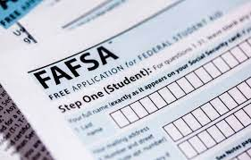
Better FAFSA
Stephani Berry, Director of Financial Aid
11:55am-12:15pm
h

Slide 15
Mass & Lunch
Feast of the Assumption
12:20pm-1:30pm

Slide 16
In other news.... Trends in Higher Education
1. Career-Focused Learning Flourishes in Modernized, Stackable Formats Colleges and universities focus on modernizing academic programs to meet the demand for more targeted, modular learning that connects to future jobs.
2. Debt-Free Education Captures Attention With student loan forgiveness spotlighting the high cost of a college degree, institutions look to help students fund their education without taking on significant debt.
3. Institutions Rework Financial Models and Revenue Streams to Attain Sustainability With tuition revenue becoming less reliable, colleges and universities invest in alternative approaches to ensure long-term financial stability via new sources of income.
4. Inclusion and Support Services Build Connection, Acceptance, and Success A strong link between student belonging and persistence drives institutions to ramp up student-centered support and success services to ensure every enrollee is mentally, socially, and academically prepared for college life.
2023 Hanover Research
This Photo by Unknown author is licensed under CC BY-SA-NC.

Slide 17
How to Get a 5-Star Review from Gen Z on Employee Experience
1:30pm-2:30pm
Angela Kennedy | Speaker, Storyteller, Lead Dream Maker
Owner, AoK Consulting

Slide 18
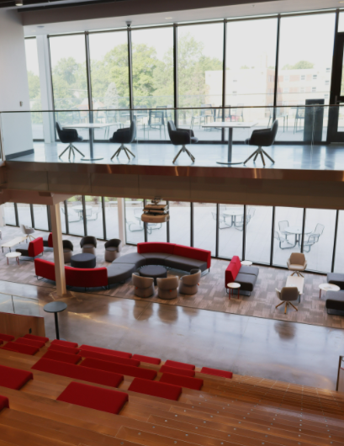
In other news....
3 Reasons to Attend a Catholic College-According to the Pew Research Center, approximately 66 percent of college graduates are Christian.
A faith-based university will foster spirituality and relationships with God.
Clearly, the Catholic Church includes very diverse beliefs and world views. A Catholic higher education will expand one’s world view, introduce different lifestyles and maintain a fundamental spiritual view.
Students will receive both spiritual and educational guidance.

Slide 19
Community Updates 2:30-3:30pm – Everyone
HR/Title IX
Payroll
Policies/Procedures
Student Affairs
Business Affairs
Advancement
Academic Affairs

Slide 20
Please complete the workshop assessment. Thank you!

Slide 21
Social Hour! 4:00pm-4:30pm
Please scan the QR code on your table and complete the workshop survey.

