Slide 1
Donnelly College Workshop
January 16, 2024
Lisa Stoothoff, COO, Dean of the College

Slide 2
Mass 8:00am Blessed Seelos Chapel
Msgr. Stuart Swetland, Officiant

Slide 3
Breakfast and Staff Introductions
8:30am

Slide 4
President’s Report
Monsignor Stuart Swetland
8:45-9:15 am

Slide 5
2024-2025 Common Read Reveal

Slide 6
College Updates From Your VPs 9:15-9:45 am
Emily Buckley
Dr. Mary Pflanz
Lisa Stoothoff
Dr. Elton Norman

Slide 7
GENERATIVE AI: An Introduction for Higher Education Mike Gochis 9:45-11:00 am

Slide 8
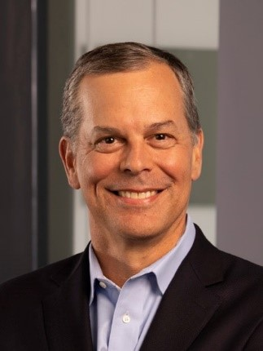
Mike Gochis, Microsoft
Michael (Mike) Gochis is a graduate of Shawnee Mission South High School in Overland Park, KS. He is also a 1990 graduate of the US Naval Academy with a Degree in Aerospace Engineering. He also has a Master Equivalent in Nuclear Engineering from the Navy Nuclear Power School and an MBA from the University of Kansas.
While on Active Duty in the Navy, he served as an engineering officer on two nuclear powered cruisers, the USS Texas (CGN-39) and USS South Carolina (CGN-37).
After leaving active duty, Mike joined Andersen Consulting (now Accenture) as an IT consultant. He next worked at Sprint in various positions. After working at Sprint, he moved to Microsoft where is has spent over 11 years working with IT technology including AI. Currently, he is a Modern Workplace Solution Specialist.
In addition to his time in the civilian workforce, Mike completed his 30-year Navy career in the Navy Reserve.

Slide 9
AI: Introduction and Background
I. Introduction
What is Generative AI? · 10 AI terms everyone should know
II. Background
History of AI · 4 misconceptions of AI
Responsible AI Topics -Responsible Principles and Approach
·The digital divide and access to technology
·Balancing human interaction with AI tools

Slide 10
Generative AI Policy (portions adapted from Middle TN State University and University of Kansas) The rapid development and widespread availability of AI raises ethical concerns for academic integrity. It is imperative that all work submitted should be your own. Use of generative AI, including but not limited to, Chat GPT, Google Bard, Midjourney, DALL-E, etc., is explicitly prohibited unless otherwise noted by the instructor. The information derived from these tools is based on previously published materials. Therefore, using these tools without proper citation constitutes plagiarism. Additionally, be aware that the information derived from these tools is often inaccurate or incomplete. Any assignment that is found to have been plagiarized or to have used unauthorized AI tools may be subject to disciplinary action as an academic integrity violation. The instructor maintains the right to investigate whether the submitted work is original.
III. AI in the Workforce Today
Impact of AI in the workforce
·Impact of AI in Healthcare
·Demonstration of AI Tools
IV. Staff and Faculty Shift to Department Groups
How should AI be integrated into the learning process considering how it is used in the workforce?
How can AI impact students for the positive and the negative?
What changes should be proposed to the Donnelly College policy on Generative AI?

Slide 11
BREAK 11:00-11:15 am
This Photo by Unknown Author is licensed under CC BY

Slide 12
Department Updates

Slide 13
LUNCH
12pm-1pm

Slide 14
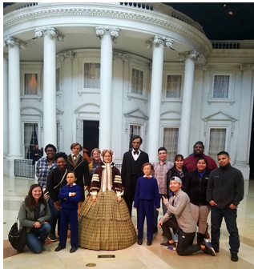
Poverty Simulation Megan Kelly, DNP, APRN, PMHNP-BC 1pm-3pm

Slide 15
This map shows what share of a zip code’s residents are low income for the three counties in the Kansas City metropolitan area that have the largest overall immigrant populations: Johnson County, Kansas; Wyandotte County, Kansas; and Jackson County, Missouri. 66102 Low-income share of the population:44% 66101 Low-income share of the population: 56%% low-income-share-population-kansas-city-metro-area
JANUARY is National Poverty Awareness in America Month

Slide 16
Building on Foundations
A FORMATIVE TOOL AND APPROACH TO ASSESSING STRATEGIC PLANS IN HIGHER EDUCATION
3pm-4pm

Slide 17
Step 1
Start with Mission, Vision, and Values: Catholic Identity
STEP 2
PRIORITIZE OBJECTIVES:
Grow Enrollment
Grow Endowment
Increase Organizational Effectiveness
STEP 3
Use the Formative Assessment Rubric to assess Donnelly College’s Strategic Plan

Slide 18
Does our Strategic Plan take us from Point A to Point B? A FORMATIVE TOOL AND APPROACH TO ASSESSING STRATEGIC PLANS IN HIGHER EDUCATION
“Strategic Plans should be formatively assessed to make informed changes throughout the process.”
(1) “Where are we now?”
(2) “Where are we going?”
(3) “How will we get there?”
(4) “How will we know we are there?”
(5) “How can we keep it going?”

Slide 19
Workshop Evaluations-Please complete the survey found in your email.

