Slide 1
Academic Affairs Donnelly College
Board of Directors Orientation
August 1, 2023 Lisa Stoothoff, COO/Dean of the College

Slide 2
Agenda
Dean of the College
Academic Affairs
Student Affairs
COO Responsibilities
Organizational Flow
- Strategic Plan Updates
HLC Accreditation
Policies and Procedures

Slide 3
Academic Affairs
Faculty for Main Campus and Lansing Correctional Facilities
College Credit Now (Coordinator of Academic Affairs)
College Workshops
Assessment Council (Coordinator of Curriculum, Assessment and Distance Learning)
Administrative Council
Academic Council
Convocation/Graduation
Title V
Academic Calendar
Academic and Student Affairs Leadership Team
Accommodations
Common Read
Student Success Academy
Professional Development Trainings
Articulation Agreements/MOU
Dean's List, Honor Roll, Suspension and Probation
Course Schedules
Bookstore
Distance Learning Modality expansion
Building/Office Assignments
Title IX (students)
Academic Affairs Committee of the Board
Annual Budgeting Process with CFO

Slide 4
Academic Affairs-Faculty
Faculty
Humanities, Liberal Arts & Sciences, Business Leadership (BA), Nursing (LPN certificate, RN)
13 FT and 20-30 adjuncts (per semester)
FT teach up to 5/5 load (5 classes per semester or 15 credit hours)
FT faculty hired on a rank and promotion process but no tenure.
Adjuncts hired per credit hour, teaching up to 9 CRHRS per semester
Nursing clinical adjuncts (10 per semester) paid per hour.

Slide 5
Programs Offered
Associate Degrees
Bachelor Degree
Certificates
Associate of Arts
Associate of Science
Associate of Applied Science:
In Nursing (Bridge Program)
In Information Technology
In Business (Lansing CF)
Bachelor of Arts in Business Leadership
Licensed Practical Nurse
IT
Business

Slide 6
What's Next for Academics?
Associate of Science in Public Health-Capture overflow of nursing applicants and those interested in healthcare.
Bachelor of Science in Nursing-Bridge for RN students
Certificate Programs (online modality for AAS in IT/Business classes)
Prior Learning Assessment-Allows adult learners to apply work skills to college credit.

Slide 7
Strategic Enrollment

Slide 8
Student Affairs-Staff
Assistant VP of Student Affairs-Dr. Mary Pflanz
Advising
Library
Counseling
Career Services
Campus Cupboard
Career Closet
Tutoring
Lansing Correctional Facility
College Catalog
Emergency Funds
Dean of the College-Lisa Stoothoff
Registrar
Admissions
Financial Aid
IT
Facilities

Slide 9
Chief Operating Officer
-Strategic Plan Updates
-HLC Accreditation-ALO
-Policies and Procedures
-Restorative Justice

Slide 10
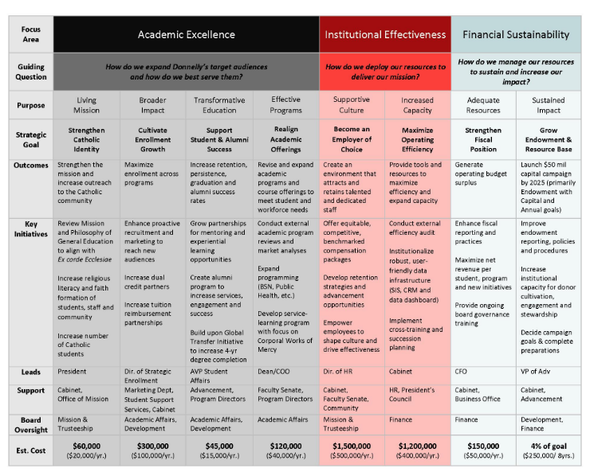
Strategic Plan 2022-2025

Slide 11
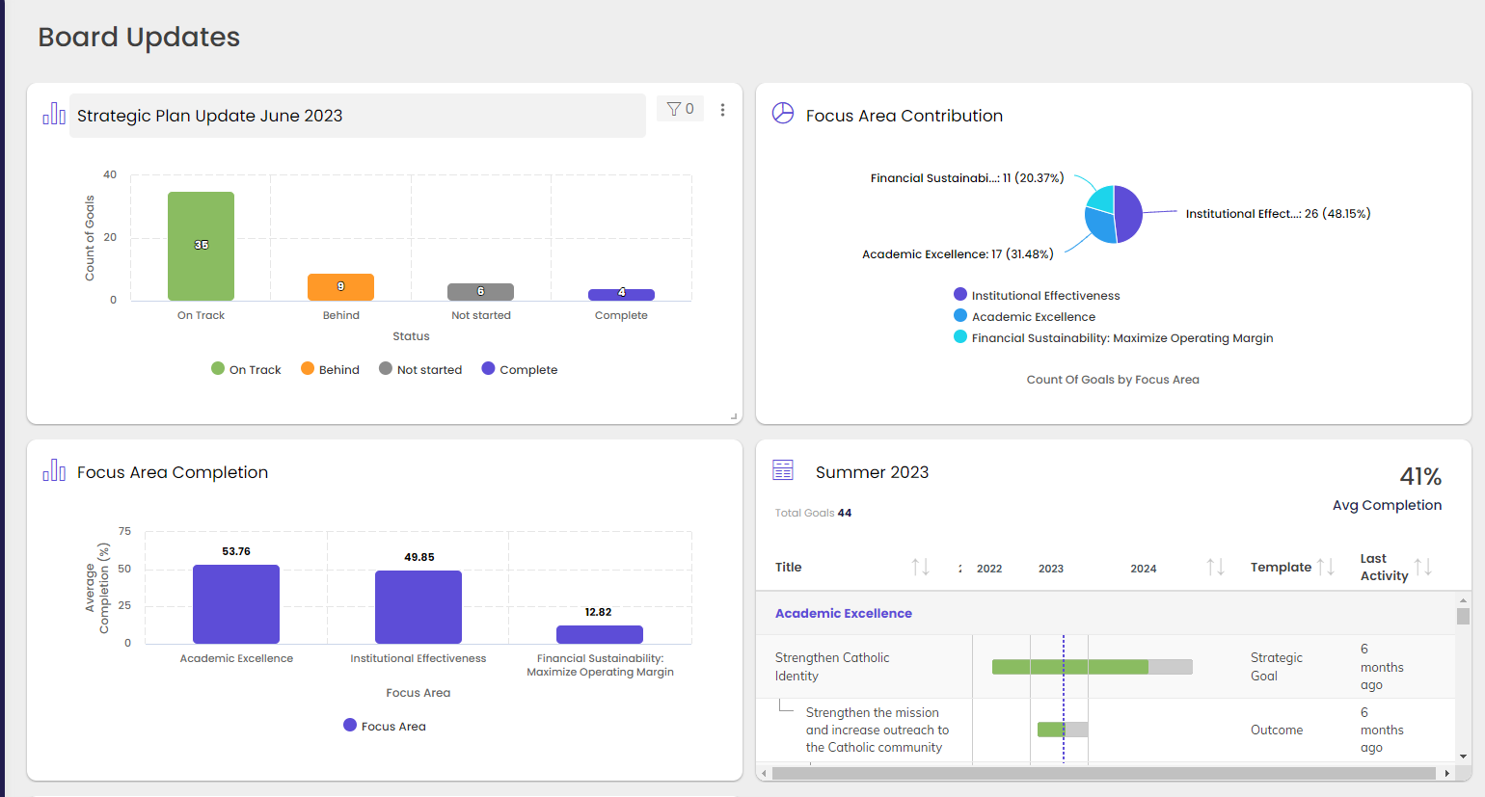
Strategic Plan Updates
Cascade Software to Assess Progress

Slide 12
Strategic Enrollment

Slide 13
Strategic Plan Priorities Academic Excellence
Strengthen Catholic Identity
Review Mission and Philosophy of General Education to align with Ex Corde Ecclesiae
Increase number of Catholic students.
Realign Academic Offerings
Revise and expand academic programs and course offerings to meet student and workforce needs.
Expand programming (BSN, Public Health)
Develop service- learning program with focus on Corporal Works of Mercy.

Slide 14
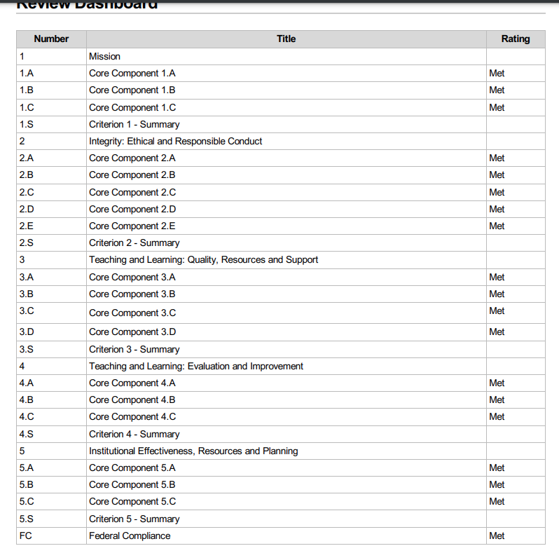
HLC Accreditation
4 Yr. Visit Feb. 20-21, 2023
Next visit: 2028-2029

Slide 15
Budget Process
Budgeting Process – The College’s budgeting process begins in December when the COO and CFO convene all departmental directors for a preliminary discussion of each department’s budget needs for the upcoming year. This meeting is designed to ensure that all department heads understand the nature and scope of budget needs across the college. Each department then meets together in January to formalize their initial budget requests.
Once all budgets have been submitted, the COO and CFO meet individually with department heads to review budget requests as compared to past spending and to assessment outcomes and strategic goals. After this meeting, department heads revise and resubmit their budget requests to the COO and CFO. All budget requests must explicitly link funding requests to assessment and strategic goals.
The COO and CFO then compare requested budget amounts to projected revenue and recommend adjustments as needed to bring projected expenses in line with revenue. The proposed budget is presented to the Board’s Finance Committee for review and approval before being presented to the full Board at the February meeting. Further adjustments may be made by the Cabinet prior to the approval vote by the Board in May.
Once the Board has approved the budget, the CFO and COO meet with department heads to review their approved budget. Department heads sign their approved budget, and the Business Office tracks actual expenses against the approved budgets throughout the fiscal year.

Slide 16
College Policies and Procedures

Slide 17
Compliance with GLBA-Safeguards Rule
US Dept. Of Education applies to all postsecondary institutions that participate in financial aid programs under Title IV.
Institutions are required to develop and implement an information security program and appoint an Information Security Officer on campus.
Cybersecurity and data privacy are critical for protecting student information. We must be prepared for a security breach and have a plan to respond to one.
Financial implications for the college

Slide 18
Lisa Stoothoff
Lstoothoff@donnelly.edu
913-621-8726

