Slide 1
Bloch Scholars Program
Karen Lombardi
Bloch Scholar Program Coordinator
Donnelly College

Slide 2
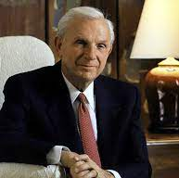
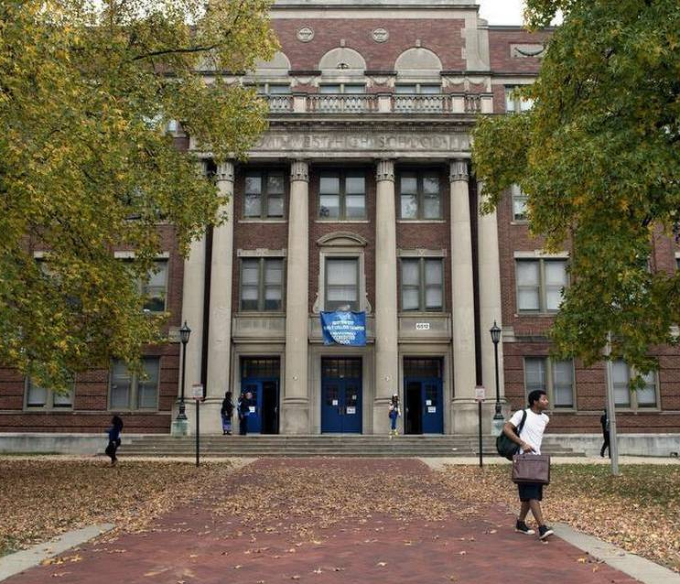
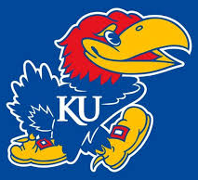
Who is Henry W. Bloch?

Slide 3
The Henry W. Bloch Scholarship was founded in honor of Henry's retirement from H&R Block in 2000. It is designed for students, like himself, who demonstrate potential, have overcome obstacles, & have the drive and determination to succeed!

Slide 4
What's So Great About Bloch Scholars?

Slide 5
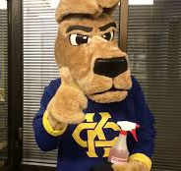
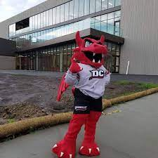
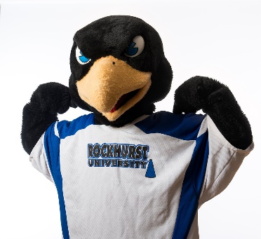
Students Earn: an Associate Degree from Donnelly & a Bachelor's Degree from UMKC or Rockhurst

Slide 6
100% of Tuition & Fees are Covered for Associate & Bachelor’s Degrees (Block Foundation pays 50%; Donnelly ensures other 50% is covered)
Scholars have a personal coach (with monthly meetings) to help learn the ropes & stay motivated!
The program is now open to all qualifying students, regardless of citizenship/residency status

Slide 7
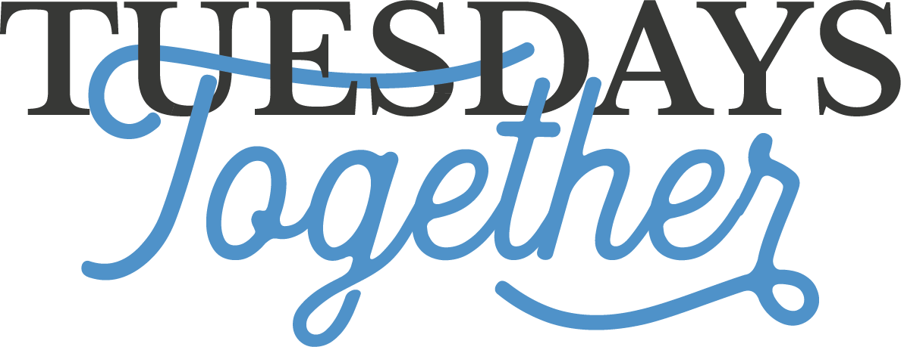
and help develop ways to build community with other Bloch Scholars at MCC, UMKC, & Rockhurst!
Students are part of a community of Bloch Scholars at Donnelly …

Slide 8
Currently: 24 Bloch Scholars on Campus 1 Bloch Scholar spot being held for Spring 1 Bloch Scholar on Wait List for Spring
Expansion will be in full swing next Fall:
50 Bloch Scholar spots for Fall 2024!
Applications Open on November 1st (due March 1st): donnelly.edu/scholarships

Slide 9
Who can apply? First-time college students OR Students transferring from other colleges with no more than 30 credits toward their Associate Degree OR Current Donnelly students with no more than 30 credits earned toward an AA degree. Students who demonstrate Financial Need (based on their FAFSA or Donnelly’s Expected Family Contribution Estimator) Students who do not qualify for other academic scholarships such as KC Scholars or Donnelly’s Presidential Scholarship Students who reside in the Kansas City metro area (Wyandotte, Johnson, Jackson, Clay, or Platte Counties)

Slide 10
Who Does not Qualify?
Nursing Students
Bachelor’s Students
Students who want to go directly into pre-professional programs such as nursing, dentistry, architecture, pharmacy, or secondary education before completing a Bachelor’s degree
Students who already have earned more than 30 credits toward their Associate degree
Students who do not reside in the KC-metro area (5 counties)
“Straight-A” Students
Students who are KC Scholars or Donnelly Presidential Scholars

Slide 11
My Role

Slide 12
Questions?

