Slide 1
Adjunct Faculty Workshop
Lisa Stoothoff, COO/Dean of the College
August 14, 2023

Slide 2
Mission. Vision. Values Msgr. Stuart Swetland, President Fr. Maclean Aaku, Campus Priest Office of Mission
What is a Catholic College?​
Is Catholicism part of the curriculum?​
What faith-based activities and clubs are at Donnelly?​
What if I'm not Catholic, or not Christian?​

Slide 3
Office Hours
While you are not required to hold regularly scheduled office hours, please try to be available before or after class (15 minutes) or by arrangement.
Please do not provide your personal phone or personal email address to students, you are only permitted to email them on their Donnelly email address. Email through Canvas or Empower for tracking purposes.
Cubicles for use in suite 214-use your ID to enter.
2nd floor faculty suite has:
Printer
Classroom supplies
Computer stations

Slide 4
Faculty Expectations
Be Present
Academic Rigor
Syllabus
Communication
REMOTE LEARNING
Academic Alert
Attendance Policy
Common Read

Slide 5
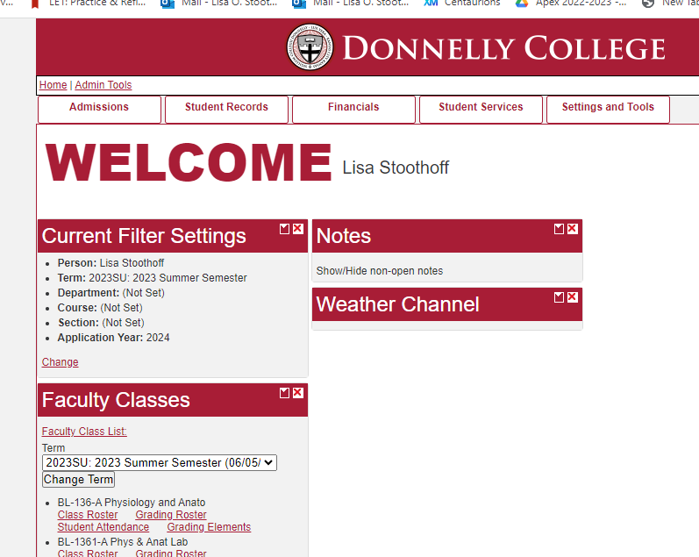
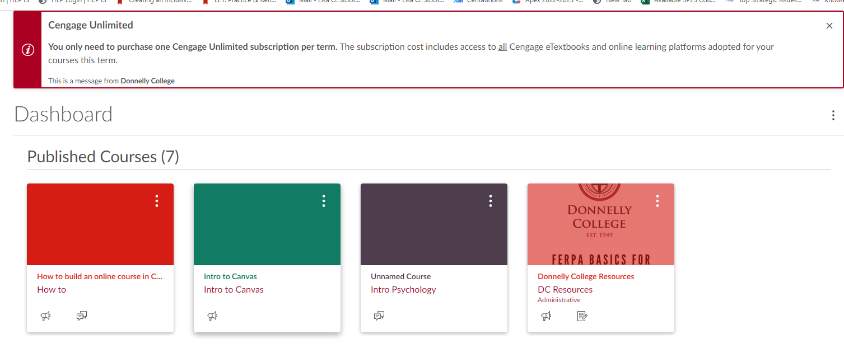
Empower & Canvas

Slide 6
Syllabus-Use the template on the website that matches your modality. How much can I change on the syllabus?​
Course Expectations​
DCLO #3 and #3Assessment of Student Learning​
DCLO, PLO, SLO-really? ​
Attendance Policy

Slide 7
Attendance Policy
Every course syllabus must have a clearly stated attendance policy.
If a student is in danger of exceeding the attendance policy, please fill out an early alert form for the student. (Forms found on website under faculty/staff-”Forms and Templates.”
An academic alert may also be filled out for failing grades, incomplete assignments or care for welfare of the student.
To withdraw a student from the course, please pick up a form in the Registrar’s office, fill out and return to Registrar. Please complete these in a timely manner.
In addition, a student may withdraw the course themselves by visiting the Registrar and/or their Advisor.
ACCURATE ATTENDANCE FROM DAY ONE!!!

Slide 8
Why attendance matters!
Financial Aid
Academic Rigor
Assessment data
Community
Retention

Slide 9
Remote Learning
Instructors do not have authority to grant a student time off from class. Please refer to an advisor /Dean of the College
If the college should switch to remote learning-be prepared. Show your students how to use BIG BLUE BUTTON on Canvas.
Please do not make individual exceptions as this causes an avalanche of responses.

Slide 10
Community emails/Calendar
Community emails are kept to a minimum. As part of the faculty, you are welcome to attend any/all events on campus at any time!
Community Calendar-Add to your calendar on Outlook.
This Photo by Unknown Author is licensed under CC BY-SA

Slide 11
Thank you for attending!​
For further assistance please contact:​
Lisa Stoothoff Rm 224 913-621-8726​ lstoothoff@donnelly.edu
Emily Jacobsen Rm 223 913-621-8777​ ejacobsen@donnelly.edu
www.donnelly.edu​

