Slide 1
TIME is the enemy
The impact of time on graduation for today’s college student and what we can do about it.

Slide 2
Activity: Describe a DC student
Keep me in mind throughout our presentation
How many credit hours does a typical Donnelly student enroll in?
How many hours a week does a Donnelly student work outside of school?
Who does the student support (family, children, friends)?
How much time does a DC student spend commuting to school/work?
What do you think their main goal is when they start at Donnelly?

Slide 3
Some facts about time
75% of today’s students are working full time (either at a job or at home) and going to class
50% of students who enroll full time at least some of the time are more likely to complete college than those who are always part time
38% of community college students are enrolled full time graduate with their associate degree
½ of working college students who work more than 15 hours per week have a grade average of C or lower.
40% of students work 30 hours or more per week
Only 25% of part time students ever make it to graduation
Time is the Enemy by Complete College America 2011
Center for Community College Student Engagement National Report 2017
Georgetown University’s Center on Education and the Workforce Report 2015

Slide 4
TIME
Full Time
Vs.
Part Time
It’s time to rethink scheduling and programs to help students attend full-time.
How ?
18.8% of Full Time Students Earn a 2 year associates degree within 4 years.
7.8% of Part Time students earn a 2 year associates degree within 4 years.

Slide 5
Brainstorm Activity
Complete College America offers up 6 potential solutions to create new, shorter, and faster pathways to degrees and certificates.
How do we see these solutions working for that Donnelly Student you described?
What are some insights (positive and negative) your group can provide about these solutions?

Slide 6
What we’re doing right
We require formal degree plans and track each student's completion.
Capped required credit hours at 120 hour for a Bachelor's degree and 60 for an associates degree.
We offer a tuition discount for students who take over 12 credit hours.
We offer alternative pathways to earn credit through CLEP, portfolios, college consortium, and are now expanding to include Aleks and other accelerated competency based courses.

Slide 7
Full Time Attendance Leads to Engagement
Active and Collaborative Learning
Student Effort
Academic Challenge
Student-Faculty Interaction
AFT
53%
SFT
51%
APT
45%
AFT
53%
SFT
50%
APT
46%
AFT
53%
SFT
50%
APT
46%
AFT
54%
SFT
52%
APT
46%
Even One Semester CCCSE 2017 National Report

Slide 8
Time is the enemy finding:
Too many students need remediation, and too few succeed when they get it.
Remedial Classes have become the Bermuda Triangle of Higher Education. Most students are lost, and few will ever be seen on graduation day.

Slide 9
Associates
Bachelor’s
It’s time to fix broken approaches to remediation
How ?
50.1% of those seeking an associate degree requires remediation.
20.7 % of those seeking a bachelor’s degree requires remediation.

Slide 10
Remedial students are less likely to make it to graduation
1 year certificate in 1.5 years
2 year associate in 3 years
4 year bachelor’s in 6 years
22.6% all students
13.9% all students
55.7% all students
13.1% remedial students
9.5% remedial students
35.1% remedial students

Slide 11
Brainstorm Activity
Complete College America offers up 6 potential solutions to address remedial education at the college level.
How do we see these solutions working for that Donnelly Student you described?
What are some insights (positive and negative) your group can provide about these solutions?

Slide 12
What we’re doing right
We use a range, not a single cut score for determining remedial coursework.
We offer intensive instruction in Reading/Writing meant for students to complete and move on to college level work in only one semester.
We offer students who test on the line of remediation a chance to take college level courses with an integrated co-requisite academic support course.
We are piloting a accelerated Math competency based course through Aleks.

Slide 13
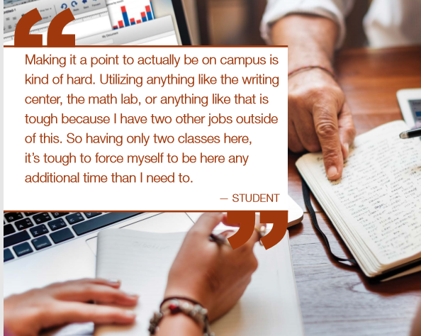
Key Takeaways
We have a new “traditional” student who has a different needs as far as time goes. We need to adapt and change to meet the demands of time on our students' schedules.
There are benefits to students being full-time, even for one semester. One of the biggest benefits is graduation, or completion.
We need to make college credits count for all students and transform our remediation program to boost college completion.

Slide 14
THANK YOU
Please complete our survey!

