Slide 1
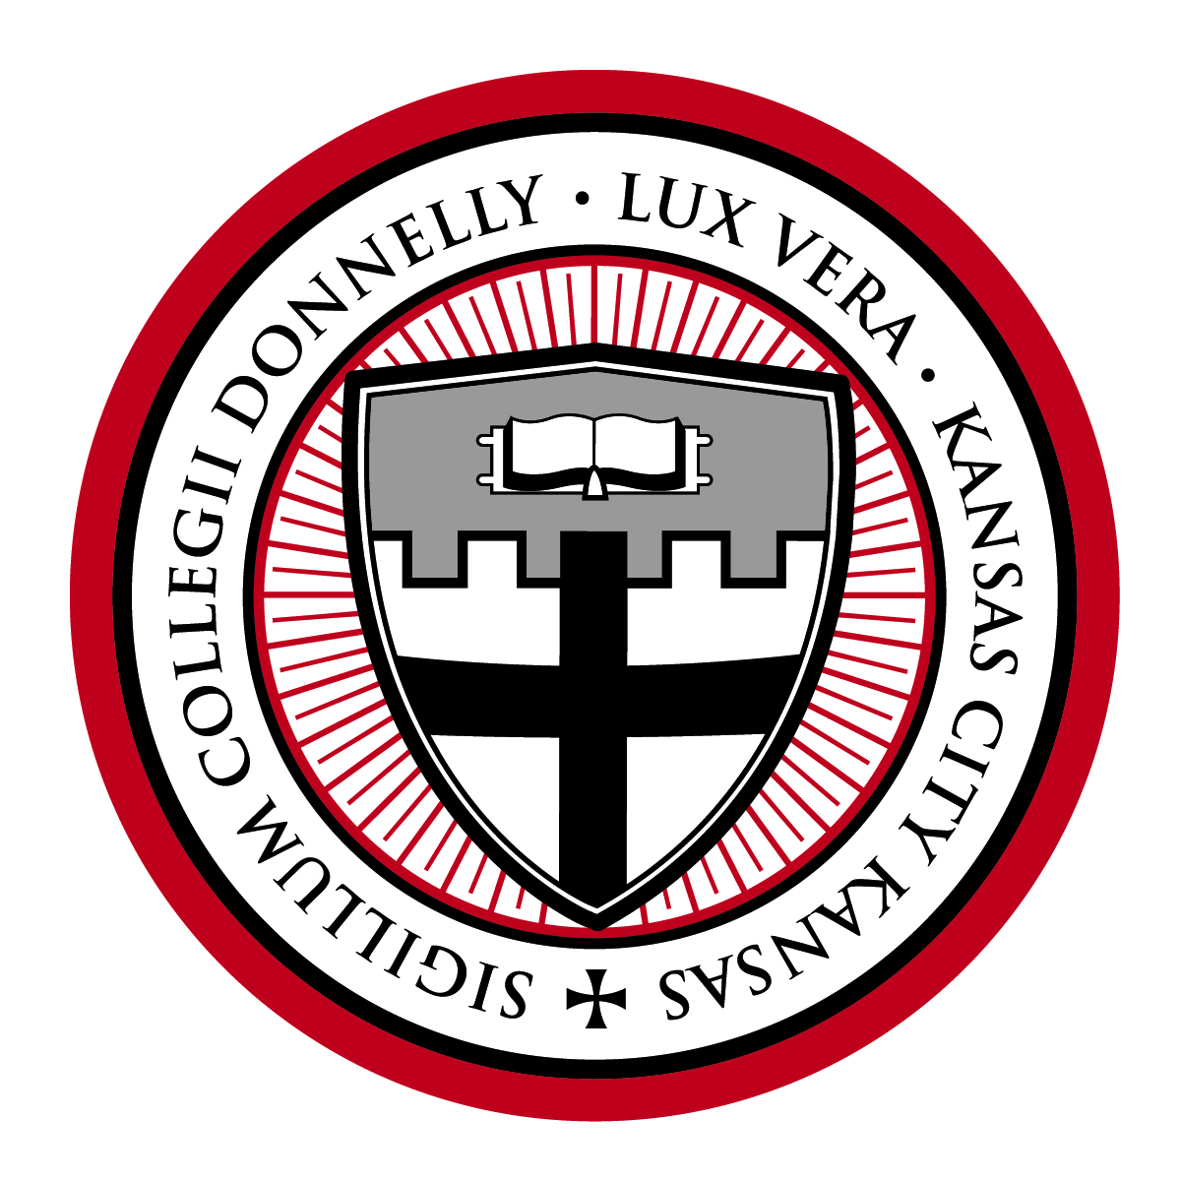
The Office of Mission

Slide 2
Who Are We?
Dr. Matthew Vander Vennet
Director
Sarah Hebel
Mission Support Specialist

Slide 3
Pop Quiz!
Donnelly College is a Catholic institution of higher education that seeks to continue the mission of Jesus Christ in our time by making the love of God tangible in our world.
Specifically, the mission of Donnelly College is to provide education and community services with personal concern for the needs and abilities of each student, especially those who might not otherwise be served.
Who can recite Donnelly's Mission Statement (without looking at their business card)?​
Donnelly College was co-founded in (1949) by the Archdiocese of Kansas City Kansas and what religious order?
Benedictine Sisters of Mount St. Scholastica
What Church document lays the foundation for the mission and vision of Donnelly College?
Ex corde ecclessiae
Notes:
Who can recite Donnelly's Mission Statement (without looking at their business card)?
Donnelly College was co-founded in (1949) by the Archdiocese of Kansas City Kansas and what religious order? (Benedictine Sisters of Mount St. Scholastica)
What Church document lays the foundation for the mission and vision of Donnelly College? (Ex corde ecclessiae)

Slide 4
Core Goals of the Office of Mission
Formation in mission for administration, staff, and faculty.
Integration of mission into academic programs and institutional policies and procedures.
Stewardship of the Catholic Intellectual Tradition through the Donnelly core curriculum, campus-wide lectures, and faculty commitment to Ex corde Ecclesiae.
Living the Catholic faith on campus in Daily Mass, Eucharistic Adoration, sacramental life, campus ministry, retreats and Catholic cultural activities.
*All goals are grounded and informed by our Catholic and Benedictine identity*

Slide 5
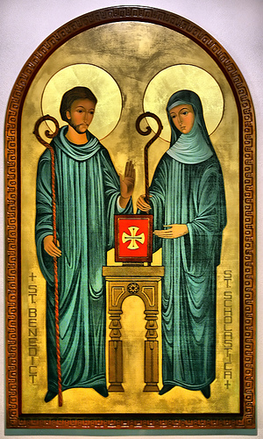
Catholic & Benedictine Identity
Donnelly College was cofounded by the Archdiocese of Kansas City in Kansas and the Benedictine Sisters of Mount St. Scholastica in 1949. Donnelly College continues in the long line of Benedictine education seeking to embody the charisms of St. Benedict and St. Scholastica in its academic and community life. Donnelly College invites students on a journey of freely searching for and discovering the truth, goodness, and beauty of all things illumined by the light of the One who made them.
As a Catholic college, Donnelly focuses on the whole person – academically, spiritually and socially – so everyone in our community can become the best version of themselves. As such, we see that everything is connected. Donnelly emphasizes a holistic and unified life supportive of the things that make us human.

Slide 6
Campus Ministry
The Office of Mission serves the student community through campus ministry.
Notes:
Student-facing activities and resources

Slide 7
How Can We Help Each Other?
Mutual support/resources
Constructive/ongoing feedback
Participation in activities and events

Slide 8
Office of Mission Initiatives
Events
Theology Thursdays, every other week, 10:15 – 10:50 AM, Dragon’s Den, Main Building
Lenten Lunch – Wednesday, March 20th, 12 - 1 PM, Bistro, Main Building
Bonnie Engstrom & Fulton Sheen Miracle, Speaker, Monday, March 25th, 3 PM, Event Center
Go Ask Your Father Q & A event, Thursday, April 11th, 10:15 – 11 AM, Assembly Stairs, Main Building
Chapel Schedule
Daily Mass, 12:20 PM, Chapel, Main Building
Adoration & Confession, Thursdays, 10:15 – 11 AM, Chapel, Main Building

Slide 9
Office of Mission Initiatives
Other Initiatives
Revamping the Campus Ministry Room
Campus Cupboard / Career Closet
RCIA Formation

Slide 10
Questions?

Slide 11
Thank you
Office of Mission
Room 240

