Slide 1
Recruiting Generation ‘P’ -What has Changed? -How do we adapt?
Tyler Seabaugh
Director of Strategic Enrollment
August 15, 2023

Slide 2
Who is Gen ‘P’?
Gen ‘P’ are students who completed most of their high school experience during the pandemic.
This study:
EAB’s 2023 Student Communication Preferences Survey
More than 20,000 current high school students
Additional data provided from surveys of high school counselors and parents from over 1,100 institutions

Slide 3
Topics for Discussion
Who is Gen ‘P’?
Six Major Factors in College Search and Mindset
Mental health concerns
Students are academically underprepared
Students are ready for in-person events
High standards for digital experiences with the college
Increased concern for the value of college
Timing of student search is shifting

Slide 4
Participant Profile
Total participants: 20,324
First Generation
First-Generation – 24%
Non-First-Generation – 76%
Grad Year
Senior – 58%
Junior – 25%
Sophomore – 17%
Race/Ethnicity
African American/Black – 15%
Hispanic/Latinx – 22%
White/Caucasian – 52%
Other – 11%
Household income
90K or less – 56%
>90K-200k – 33%
>200k – 10%
Gender
Female – 58%
Male – 38%
Other – 4%

Slide 5
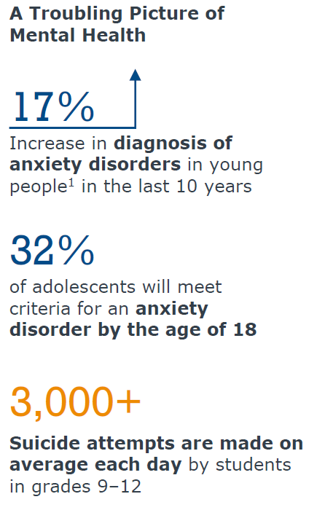
Mental Health Concerns
What can we do?
Prioritizing mental health messaging to families
Showcase our resources to students earlier in their high school career to reinforce increased support
Build on CBO relationships.
Source: C.S. Mott Children’s Hospital (2021), National Poll on Children’s Mental Health; CDC (2020), Mental Health-Related Emergency
Department Visits Among Children Aged <18 Years During COVID-19 Pandemic; https://nces.ed.gov/whatsnew/press_releases/07
_06_2022.asp, “The Mental State of the World in 2022,” The Mental Health Million Project; EAB research and analysis.
Notes:
87% of public schools k-12 reported that the pandemic negatively impacted students socio-emotional development during the 21-22 school year
84% of public schools agreed or strongly agreed that students behavioral development was negatively impacted as well.
“Im not mentally ready” –
Average is 22%, up 8% from 14 in 2019 and 2021
28% 1st gen v 20% non 1st gen

Slide 6
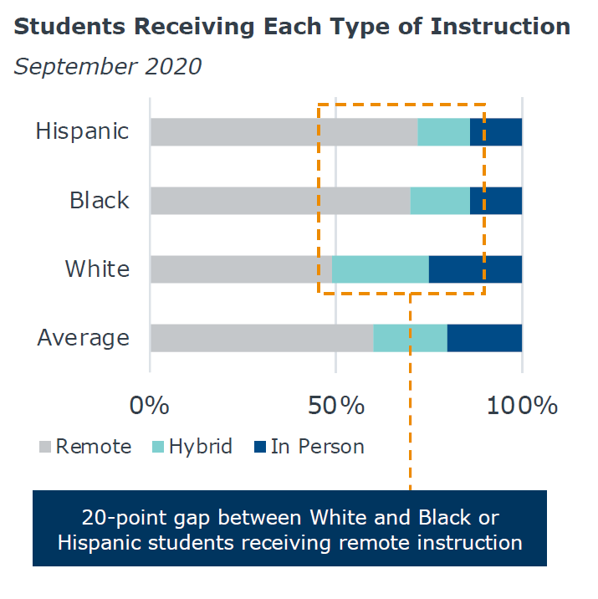
Academically underprepared Students
5-point drop in average assessment scores from ‘20-’22. This is the largest drop ever recorded by the NAEP (National Assessment of Educational Progress) Long Term Trend Assessment
Equity gaps in underserved students had less access to in-person learning during COVID
20-point gap between White and Black/Hispanic Students receiving remote instruction
Source: Shapiro, E. (2021), Missing in School Reopening Plans: Black Families’ Trust; Dorn, Hancock, et al., COVID-19 and Learning Loss – Disparities Grow, December 2020; Fairfax County ORSI, Study
of Teaching and Learning During the COVID-19 Pandemic; EAB research and analysis.
Notes:
Action items:
-Showcase our campus support in our communications and posts to the community so they know Donnelly is a place of trust and we support those students who may not feel academically prepared.
-Prioritize a sense of belonging on campus and community feel

Slide 7
In Person events
Students and families are back to participating in campus visits and college fairs.
58% of institutions saw a decrease in virtual events.
38% of institutions are reporting in-person attendance is up.
High school students are consulting with their high school counselor during their college search
Up 9% from 2021 and up 10% from 2019
Notes:
-In person is back but a varied approach to visits and event strategy is appealing to a variety of families and prospective students
-Family focus on events. We are encouraging families to join in many of our on-campus events earlier in the college search process. We are marketing to juniors via email and parent lists from local area high schools (Shawnee Mission is a major contributor to these lists) in conjunction with our other marketing and social media efforts that supplement direct email and mail.

Slide 8
High Standard for digital experiences
Web design and virtual interaction
9/10 students visit the websites of all the colleges they are considering
Responses to the survey showed that a well-designed website will improve their opinion of a college and a poorly designed website will hurt
Email is a preferred channel for college communications
Despite various reports of email fatigue, more than 75% of students expressed they want to hear from colleges via email.
Notes:
Takeaways:
Virtual engagement and multi-channel engagement are key indicators of interest…
Web design and interface interactions are highly influential on the perception of a college. Or anything… right?

Slide 9
What is the value of a college education?
Key factors:
Cost of attendance or perceived cost of attendance (student debt)
Perception of a poor ROI
Strength of job market
Increased certificate and non-degree credentials that have increased value
10% drop in college going rate from ‘16-’20 across the USA.
Decreased requirements of advanced degrees (MA, MS, BA, BS)
Students are getting jobs with the 2-year degree or getting a job before finishing the BA/BS
Notes:
Most common factors that deter students from attending college
-cost/student debt
- earning opportunities without college
-academic readiness
-cost of living
-LOW OR NO COLLEGE GOING CULTURE IN THEIR COMMUNITY

Slide 10
Current Student Values
Notes:
What are you looking for?
- Affordable tuition
-internships, co-ops, active learning experiences
-career relevant programs
-strong job prospects for graduates
-safe campus environment
So what do we do?
Build partners, open the doors for students finishing degrees, leverage relationships, activate young alumni to showcase success
Demonstrate career readiness

Slide 11
Recruitment season is later
What does the data say?
2019, 67% of high school students started researching college by the end of their sophomore year.
2023, 40% of high school students started researching college by the end of their sophomore year.
Comparing Financial Aid award offers
Takeaways:
Flexible and responsive approach to enrollment marketing, students are less-predictable
Test optional is appealing, but placement is necessary.
Notes:
Test optional came up in this section of the report. Students did apply to a good number of schools because they were test optional but only roughly 1 in 5, about 19-20% on average.
- 26% for Black/African American
-25% for Hispanic/Latinx

Slide 12
Credit
EAB Survey of Student Communication Preferences
Project Director:
Lizzy Donaher
Contributing Consultants:
Anne Dodson
Michael Koppenheffer
Pamela Kiecker Royall, PhD

Slide 13
Questions?

