Slide 1
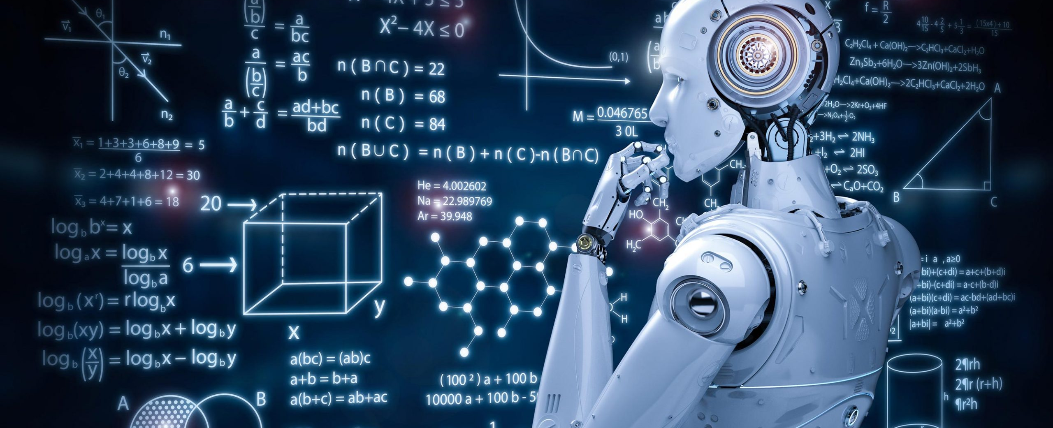
Introduction to Generative AI
Notes:
This presentation will introduce Generative AI and provide information on the vocabulary of Generative AI.

Slide 2
DISCLAIMER
All of the content of this presentation is public domain and available on-line. The information presented here is the opinion and research of Mike Gochis and does not necessarily reflect the official opinion of Microsoft or any of its related companies. Mike is solely responsible for the content in this deck.

Slide 3
Agenda
Introduction
What is Generative AI?
Vocabulary of Generative AI
II. Background
History of AI
4 Misconceptions of AI
Responsible AI Topics
The digital divide and access to technology
Balancing human interaction with AI tools
III. AI in the Workforce Today
Impact of AI in the workforce
Impact of AI in Healthcare
Demonstration of AI Tools
IV. Q&A
V. Staff and Faculty Shift to Department Groups
VIII. Conclusion
Notes:
This slide will provide a brief history of AI and discuss some common misconceptions surrounding AI. It will also discuss responsible AI topics, the digital divide, and how to balance human interaction with AI tools.

Slide 4
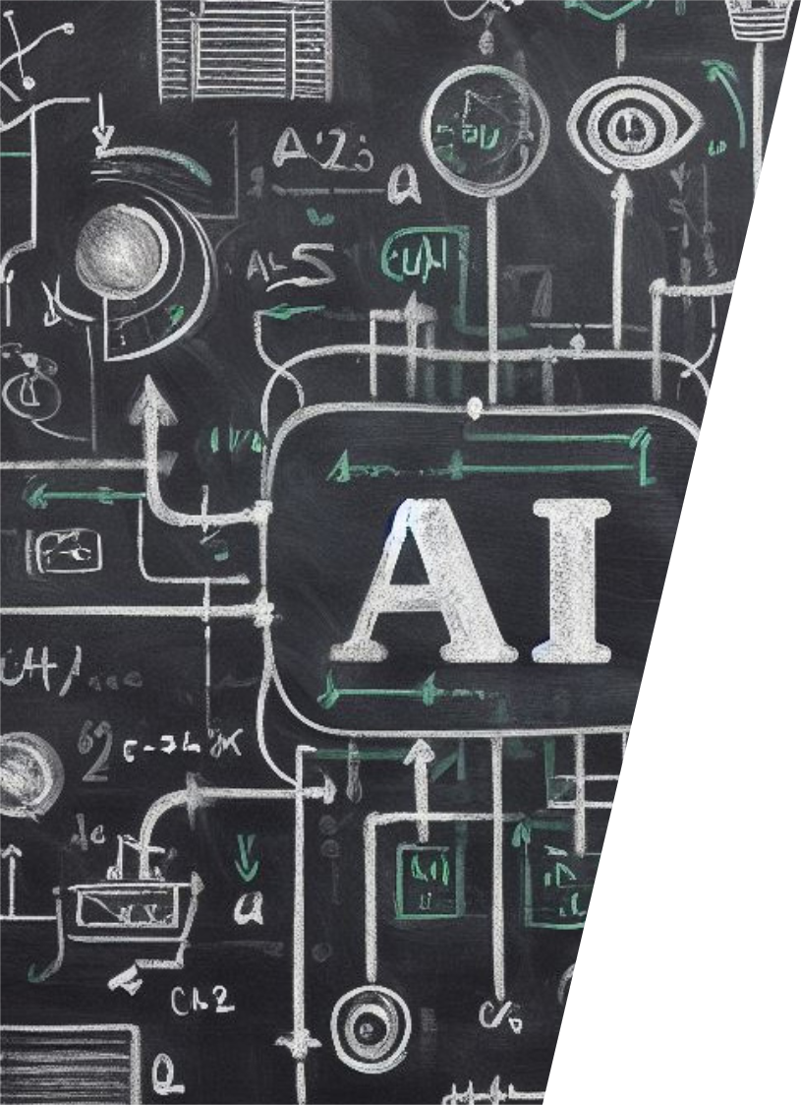
Generative AI
Generative AI (GAI) is a type of artificial intelligence that can generate new content such as text, images, or other media using generative models
Generative AI models learn the patterns and structure of their input training data and then generate new data that has similar characteristics.
Notes:
Generative AI refers to machine learning algorithms that can generate new data, such as images, videos, and even text, that is similar to the data it was trained on. This is achieved through deep learning techniques and neural networks. Applications of generative AI include creating realistic images of people or things that don't exist, generating realistic voice and text, and even creating new music.

Slide 5
10 Vocabulary Words for AI
Generative AI
Machine Learning
Neural Networks
Natural Language Processing (NLP)
Deep Learning
Supervised Learning
Unsupervised Learning
Reinforcement Learning
Computer Vision
Artificial General Intelligence (AGI)
Notes:
These are the 10 most frequently used AI Vocabulary words that you should be familiar with in AI, according to Microsoft.com. Generative AI refers to AI technology that can generate new content. Machine learning refers to the ability of machines to learn how to perform tasks. Neural networks refer to a set of algorithms that simulate the way human brains work. Natural language processing (NLP) is the ability of machines to understand and generate human language. Deep learning refers to the ability of machines to learn and improve over time. Supervised learning is the process of training a machine to learn from labeled data. Unsupervised learning is the process of training a machine to learn from unlabeled data. Reinforcement learning is a type of machine learning that involves learning by trial and error. Computer vision is the ability of machines to recognize and interpret visual information. Artificial general intelligence (AGI) refers to machines that have the ability to think and reason like humans.

Slide 6
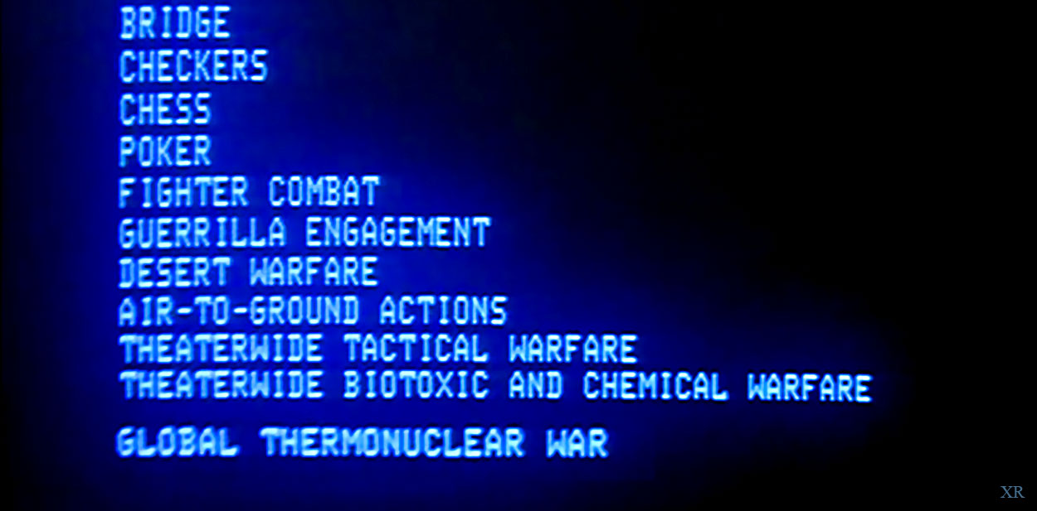
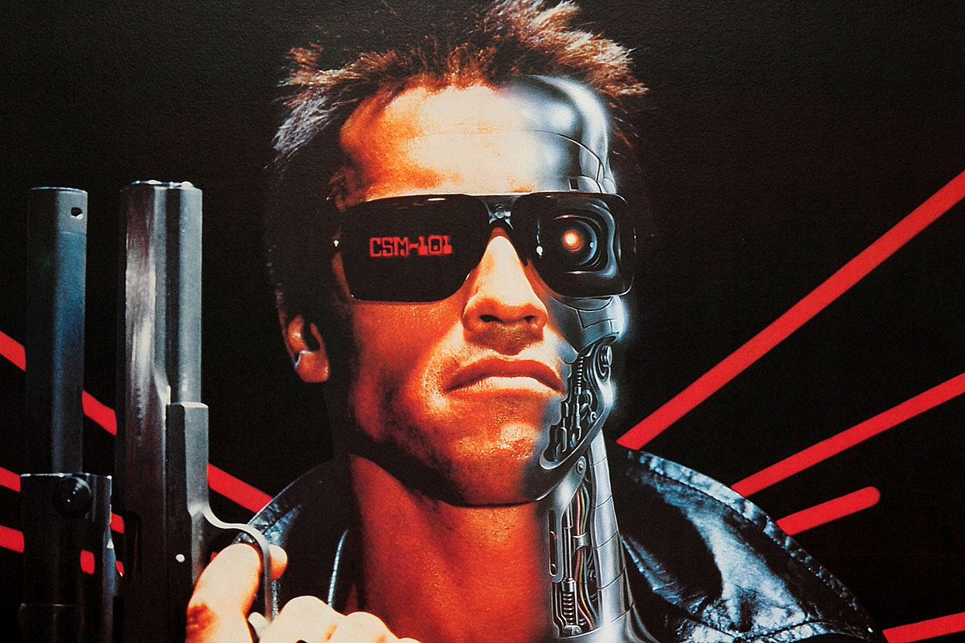
History of AI in film
1968 – 2001 a Space Odyssey – HAL-9000 – “I’m sorry, Dave”
1983 – War Games – WOPAR (Joshua) – “Would you like to play a game?”
1984 – Terminator – “I’ll be back”
2004 – I, Robot
Isaac Asimov’s 3 Laws of Robotics – 1950’a
A robot may not injure a human being or, through inaction, allow a human being to come to harm.
A robot must obey the orders given it by human beings except where such orders would conflict with the First Law.
A robot must protect its own existence as long as such protection does not conflict with the First or Second Laws.
2008 – WALL-E

Slide 7
History of AI
1950’s – Introduction of Artificial Intelligence as a science – Frank Rosenblatt proposes the first architecture of a device that simulates processes in the human brain.
1960’s – Expansion of 50’s research and first computer question and response functionality
1980’s – First Recurrent Neural Networks (RNN) which can generate sentences
Early 2000’s – Expansion of Data Science and predictive modeling
2010’s - Advancements in deep learning architectures and image based AI
2020’s – Launch of highly available Generative AI tools such as DALL-E and ChatGPT
Parallel advancements in computing power and memory required to support Generative AI

Slide 8
Myths of AI
AI will take everyone’s Job
AI is only for People that Wok in Tech
AI is one thing
AI is inherently biased and should be avoided
Source: 4 misconceptions about AI (microsoft.com)
Notes:
AI has many myths around it, but most of them are untrue. AI is not here to take over the world or your jobs. It is a tool to help people make better decisions and augment their capabilities. AI is not only for big companies, small businesses can also benefit from it. And AI is not too complex for non-experts, as there are many tools out there that are easy to use. Let's explore some of the myths around AI and see what the reality is.

Slide 9
Microsoft’s AI principles
Microsoft Cloud — AI you can trust
Fairness
Reliability & Safety
Privacy & Security
Inclusiveness
Your data is your data.
Your data is not used to train the OpenAI foundation models without permission.
Transparency
Your data is protected by the most comprehensive enterprise compliance and security controls.
Accountability
Notes:
Microsoft believes that the development and deployment of AI must be guided by the creation of an ethical framework.
We have six core principles that should guide the work around AI. Four core principles of fairness, reliability & safety, privacy & security, and inclusiveness, underpinned by two foundational principles of transparency and accountability.
The first principle is fairness. For AI, this means that AI systems should AI systems should treat everyone fairly and avoid affecting similarly situated groups of people in different ways.
The second principle is reliability and safety. To build trust, it’s also important that AI systems operate reliably, safely, and consistently under normal circumstances and in unexpected conditions.
It’s also crucial to develop AI systems that can protect private information and resist attacks.
For the 1 billion people with disabilities around the world, AI technologies can be a game-changer. Inclusive design practices can help system developers understand and address potential barriers in a product environment that could unintentionally exclude people.
Improving intelligibility requires that stakeholders comprehend how and why AI systems function so that they can identify potential performance issues, safety and privacy concerns, biases, exclusionary practices, or unintended outcomes.
Our final principle is accountability. We believe the people who design and deploy AI systems must be accountable for how their systems operate.
Data is the fuel that powers AI technology – and you need to trust what your technology partners are doing with your data.
First, your data is your data. That means it is yours to own and control. Your data to chose how you want to leverage and monetize.
Your data is not used to train or enrich the foundational AI models used by others without your permission, so you don’t have to worry about anyone other than your organization benefiting from AI that is trained on your data.
And your data and AI models are protected at every step by the most comprehensive enterprise compliance and security controls in the industry.

Slide 10
Digital Divide in the US
Key components of the digital divide in the US:
Race, Ethnicity, Language
Educational Opportunities and School Districts
Income Driven Divides
Internet Access
Communications Infrastructure – Urban, Sub-urban, Rural

Slide 11
AI in the Workforce Today
Impact of AI in the Workforce
Impact of AI in Healthcare
Demonstration of AI Tools
Notes:
This slide will discuss the impact of AI in the workforce with a particular emphasis on healthcare. It will also provide a demonstration of some AI tools.

Slide 12
Generative AI in nursing and healthcare
AI can help diagnose diseases by analyzing medical images and identifying patterns that humans might miss.
AI can help physicians make informed decisions by analyzing large amounts of patient data.
AI can help monitor patients in real-time and alert healthcare providers when there are any changes in patients’ health status.
AI can help mitigate the shortage of healthcare professionals by automating routine tasks and freeing up time for physicians and nurses to focus on more complex cases.
AI can improve clinical trials by identifying the right patients for trials, analyzing data, and predicting outcomes.
Notes:
Artificial intelligence (AI) is revolutionizing healthcare. With the help of AI, healthcare providers can improve patient outcomes, reduce costs, and enhance the overall quality of care. AI can help diagnose diseases by analyzing medical images and identifying patterns that humans might miss. AI can also help physicians make informed decisions by analyzing large amounts of patient data. Additionally, AI can help monitor patients in real-time and alert healthcare providers when there are any changes in patients’ health status. Another benefit of AI in healthcare is that it can help mitigate the shortage of healthcare professionals by automating routine tasks and freeing up time for physicians and nurses to focus on more complex cases. Finally, AI can improve clinical trials by identifying the right patients for trials, analyzing data, and predicting outcomes.

Slide 13
Q&A
Notes:
This slide will provide an opportunity for the audience to ask any questions they have about the presentation.

Slide 14
Staff and Faculty Shift to Department Groups
Integration of AI into the Learning Process
Positive and Negative Impacts of AI on Students
Proposed Changes to Donnelly College's Policy on Generative AI
Notes:
This slide will discuss how AI should be integrated into the learning process and how it can impact students both positively and negatively. It will also propose changes to Donnelly College's policy on Generative AI.

Slide 15
Conclusion
Notes:
This slide will provide a brief summary of the presentation and provide an opportunity for additional Q&A.

