Slide 1
New Faculty Workshop
Lisa Stoothoff, VPASA
Donnelly College August 12, 2019

Slide 2
Faculty Handbook/Expectations
Professional Development
Research Release
Committees
Office Hours
Academic Rigor
Syllabus
Canvas/Empower

Slide 3
Professional Development
Each faculty member is awarded $750 per Academic Year. Funds may accumulate for three AY. If funds are not used for PD by the end of the third year, the faculty member’s account reverts to $0.
Funds may be used for conferences (registration and travel), lectures, academic books in discipline or for educational costs (must be pre-approved by VPASA)
PD forms found on website

Slide 4
ACUE 3 CR Graduate Course-$100 stipend Effective Teaching Pedagogy

Slide 5
Research Release
Although Donnelly College is a teaching college, we value the research a faculty performs in order to advance their pedagogical skills.
Each semester, the VPASA will send out a from requesting research projects. One faculty is chosen per semester and awarded either a 3-5 credit release or the overload pay. Projects must directly correlate to subject matter being taught.
Faculty member then presents research findings at subsequent college workshop.

Slide 6
Committee Work-Ugh or Yay?
Every faculty member must serve on a faculty committee. These committees include:
Professional Development
Service Learning
Faculty Handbook
Adjunct Task Force
Online Task Force

Slide 7
Notes:
Poll Title: What are you still unsure about? https://www.polleverywhere.com/free_text_polls/FQuuCuZa8iZiNcw2EfSbw

Slide 8
Office Hours
Faculty must post and be available (as in door open) for five office hours per week. Please notify VPASA and Director if there is a conflict with office hours.

Slide 9
Academic Rigor
7 Myths About Rigor in Learning-Teach Thought
1 Lots of homework is a sign of rigor
2 Rigor means doing more
3 Rigor is not for everyone
4 Providing support means lessening rigor
5 Resources equal rigor
6 Standards alone take care of rigor
7 Rigor is just one more thing to do
On a May 2019 poll, faculty and staff both noted academic rigor as a top priority for 2019-2020

Slide 10
Notes:
Poll Title: The question I want to ask right now is... https://www.polleverywhere.com/discourses/jWugxkIqJZP05ydqi5NPz

Slide 11
Syllabus Use the template provided by Department Director How much can I change on the syllabus?
Course Expectations
Assessment of Student Learning
DCLO, PLO, SLO-really?

Slide 12
Service Learning
Apply to have your course considered for the SL designation and receive $250 that semester. When students complete 4 SL courses in their discipline, they receive an honor cord at graduation.

Slide 13
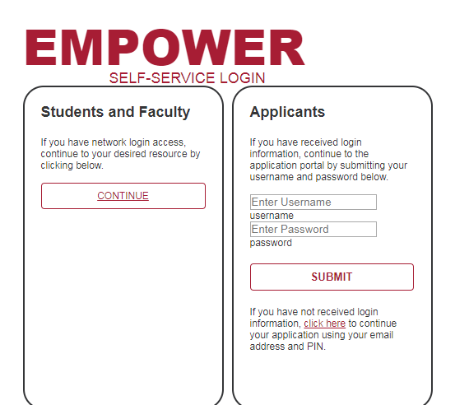
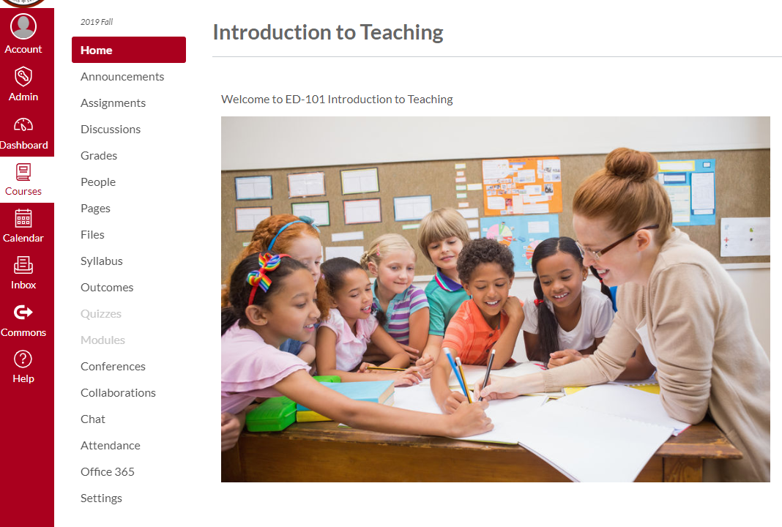
Empower-Student Information System Track daily attendance and mid-term/final grades
Canvas-Course Content-Grades
VIA-Assessment of DCLO
https://donnelly.instructure.com

Slide 14
Notes:
Poll Title: I need more help with https://www.polleverywhere.com/multiple_choice_polls/Ohp5gPunozOhW7ElQZnNS

Slide 15
Mission Vision Values
What is a Catholic College?
Is Catholicism part of the curriculum?
What faith-based activities and clubs are at Donnelly?
What if I'm not Catholic, or not Christian?

