Slide 1
Culture & Service Journeys
Donnelly College
August 2019

Slide 2
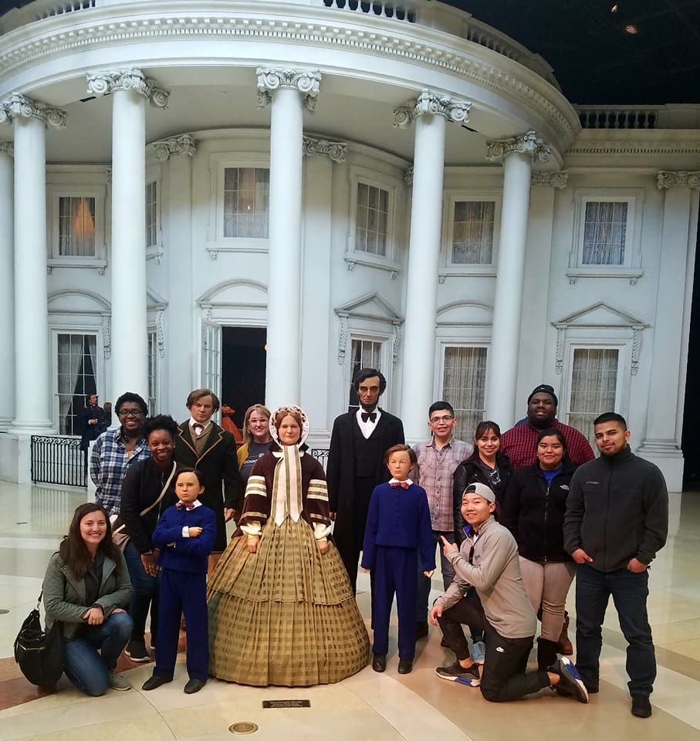
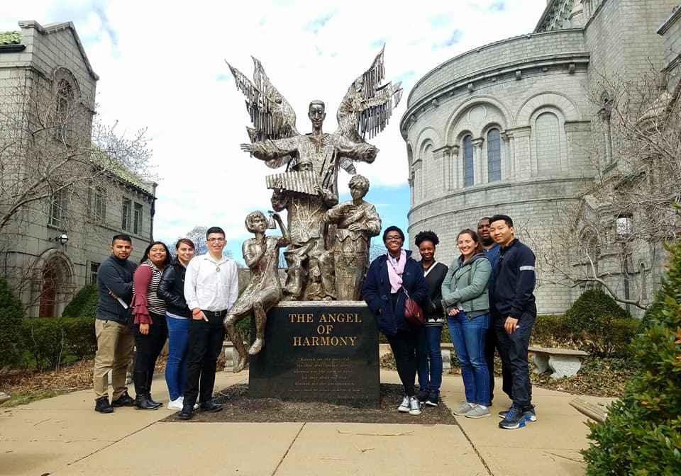
March 2018: Black History Justice Journey
Springfield, IL: Lincoln
Hannibal: Fr. Tolton & Mark Twain
St. Louis: Cathedral / Ferguson / Dred Scott Courthouse

Slide 3
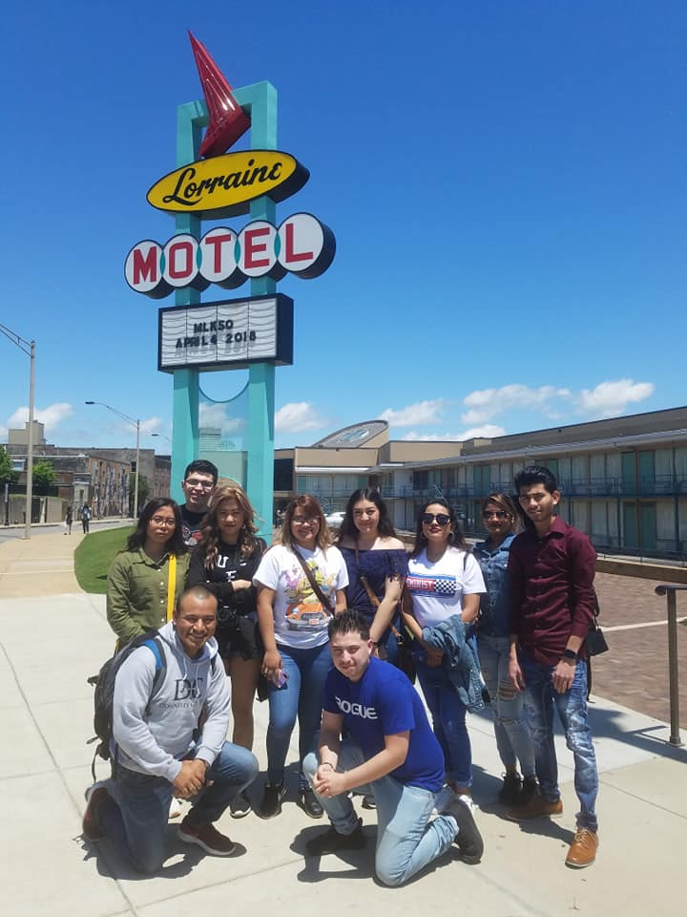
May 2019: Memphis Culture & Service journey
Five Days
10 Students
2 Faculty
Added service component
Offered as a class (optional)

Slide 4
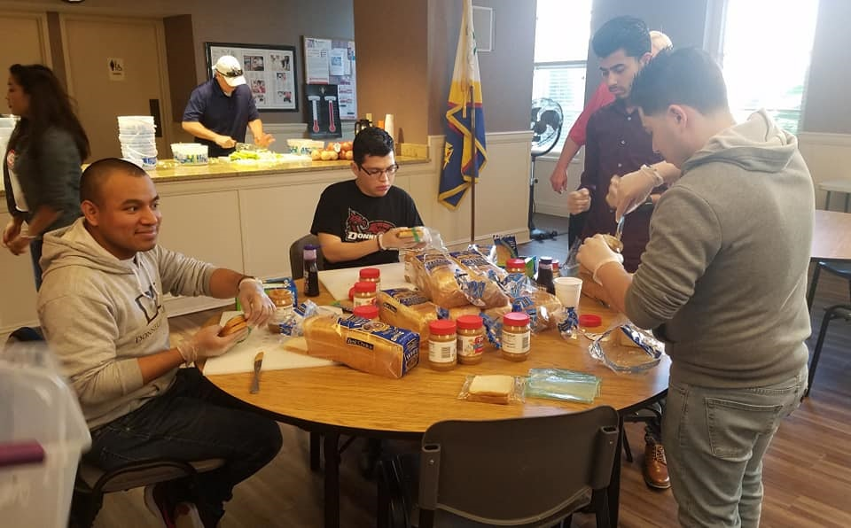
Memphis

Slide 5
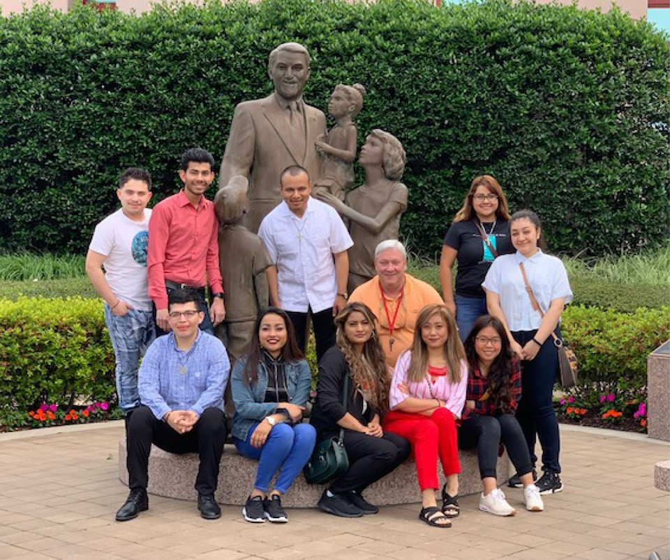
What has been the effect of this journey on you?
“THIS JOURNEY HAS CHALLENGED ME TO BECOME A BETTER VERSION OF MYSELF. I HAS CHALLENGED ME TO LISTEN TO PEOPLE’S STORIES. I NOW FEEL THAT I WILL FIGHT FOR JUSTICE WITH MUCH MORE CONVICTION.”

Slide 6
“This journey helped me to be more confident about myself & to communicate with others. I learned how to cook different things & I learned so much more about slavery. … [This was] a great experience that I will always remember.”
What has been the effect of this journey on you?

Slide 7
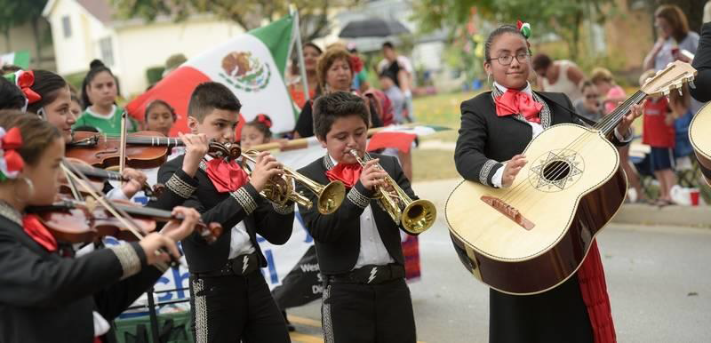
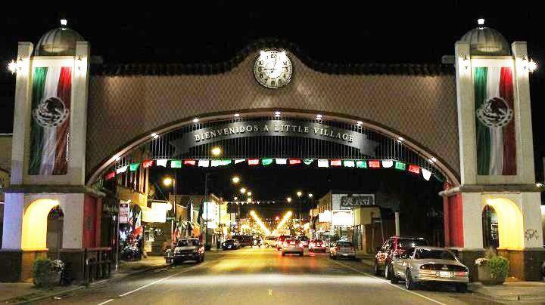
May 2020: chicago
Chicago is truly a city of immigrants—and the fifth largest Mexican city in the world. Focus of trip will be Hispanc culture & service.
We need:
** Participants!
** Offered as optional SL class – SP20
** Sponsors!

Slide 8
Questions?
Thanks for listening!

